Slide 1
Occupancy Detection
Presented By:
Rishabh Saini
18CSU172

Slide 2
Introduction
I'm using a dataset for predicting room occupancy with using environmental observations such as temperature, humidity, light and CO2 level. This predictions might help Heating, Ventilating and Air Conditioning (HVAC) sector. For instance, we are using sensors like thermostats to get information about the environment and with that info our system decides to heat or not situation. But if the thermostat set manually by a occupant before and there is no more occupants in the environment, what then? The system won't shutdown until it gets set values, and this situation will lead high energy consumption.

Slide 3
After completing this tutorial, you will know:
The Occupancy Detection standard time series classification problem in machine learning.
How to load and visualize multivariate time series classification data.
How to develop classification and regression models that achieve nearly perfect skill on the problem.
We are using the dataset Occupancy Detection Data Set, Machine Learning . This is a binary classification problem which requires that an observation of environmental factors such as temperature and light be used to classify whether a room is occupied or unoccupied. An office room […] was monitored for the following variables: temperature, humidity, light and CO2 levels. A microcontroller was employed to acquire the data. A ZigBee radio was connected to it and was used to transmit the information to a recording station. A digital camera was used to determine if the room was occupied or not. The camera time stamped pictures every minute and these were studied manually to label the data.

Slide 4
Overview
To predict room occupancy (Yes or No, binary classification) from a set of experimental data making use of the feature predictors such as Temperature,Humidity,Light and CO2.
In the experiment, ground-truth occupancy was obtained from time stamped pictures that were taken every minute.
Two data sets are considered, for training and testing. The variables in the dataset are :
1. date time year-month-day hour:minute:second
2. Temperature, in Celsius
3. Relative Humidity, as %
4. Light, in Lux
5. CO2, in ppm
6. Humidity Ratio, Derived quantity from temperature and relative humidity, in kgwater-vapor/kg-air
7. Occupancy, 0 or 1, 0 for not occupied, 1 for occupied status

Slide 5
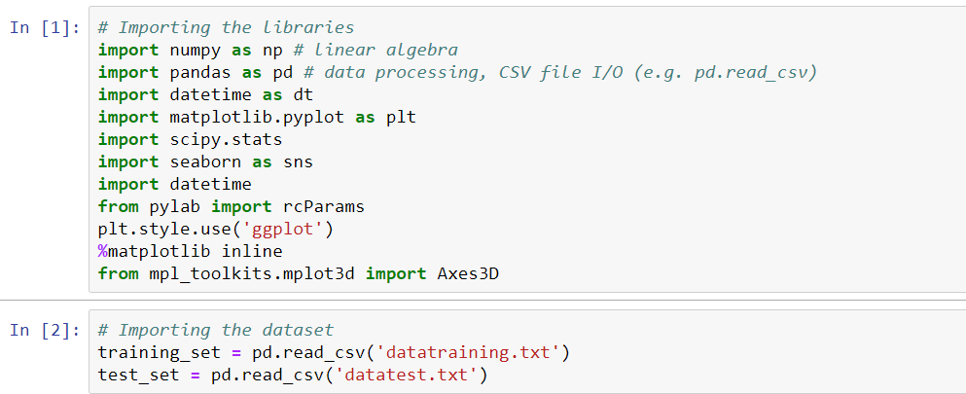
Importing Libraries and dataset

Slide 6
Exploratory Data Analysis

Slide 7
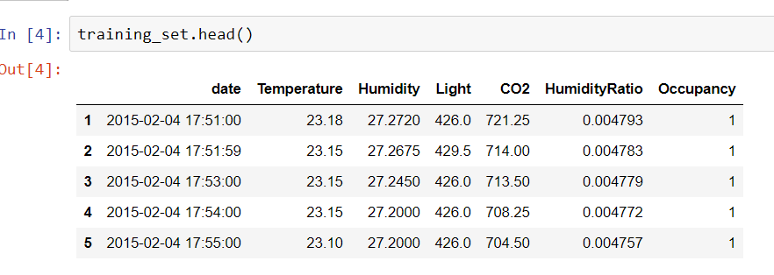
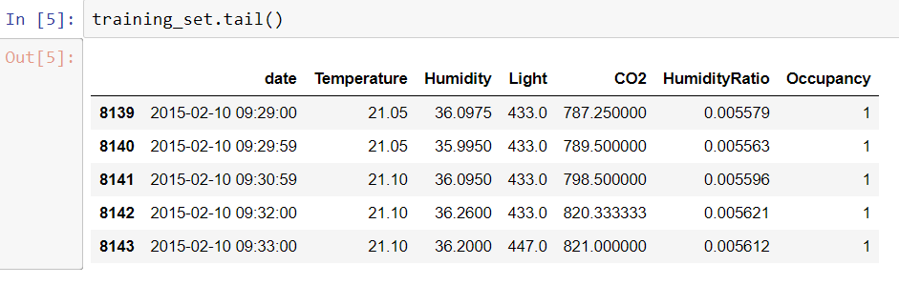

Slide 8
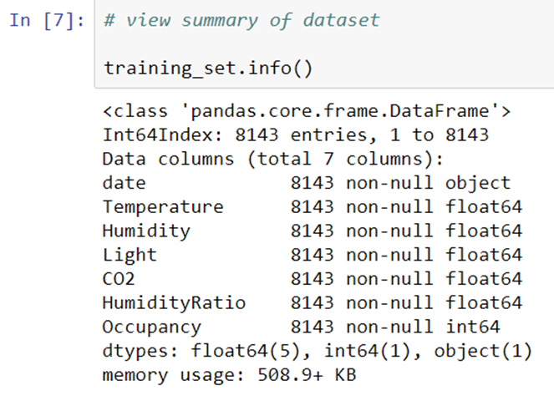
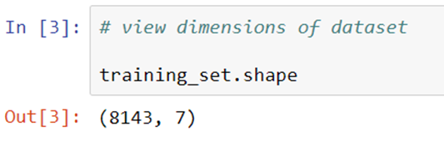
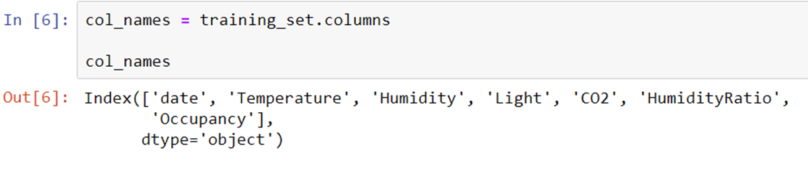

Slide 9
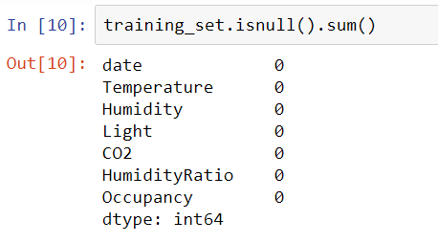
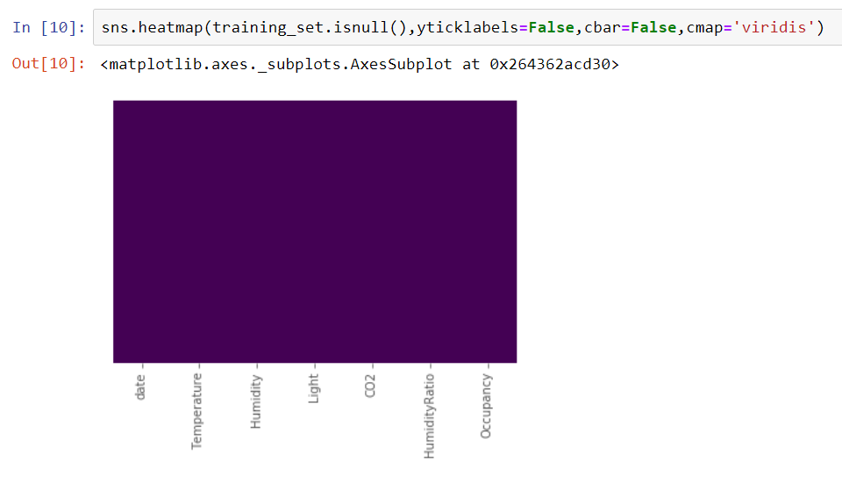

Slide 10
Data Visualization

Slide 11
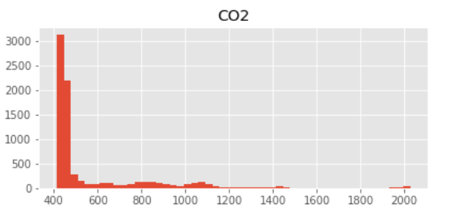
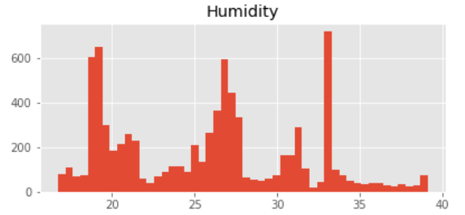
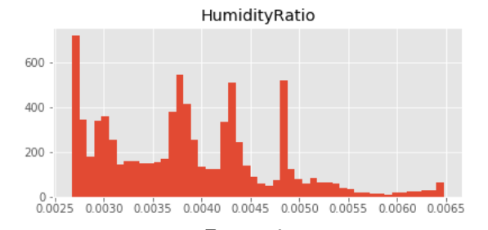
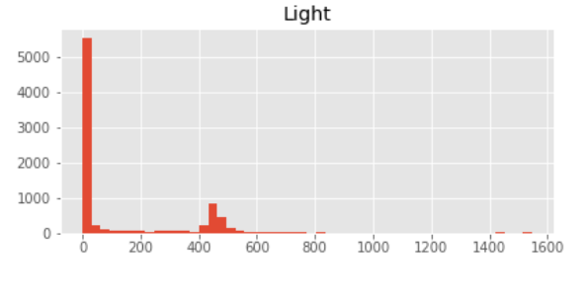
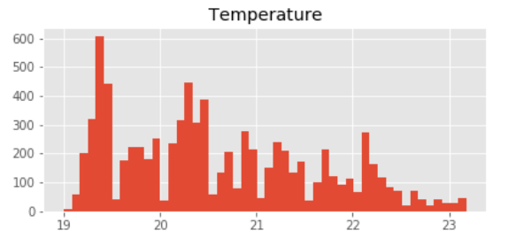

Slide 12
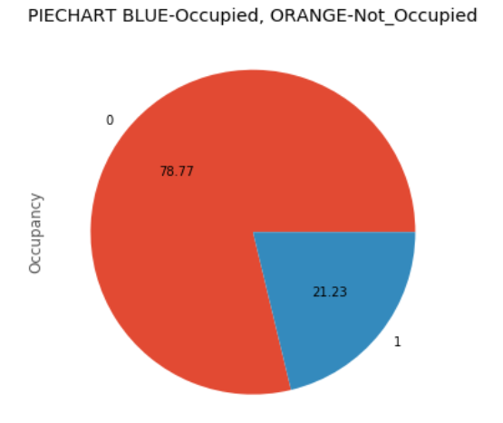
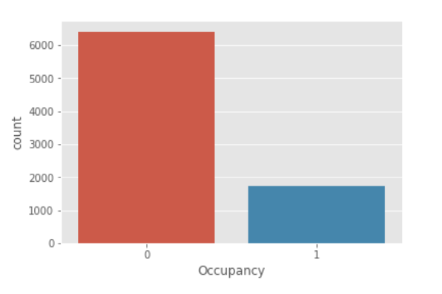

Slide 13
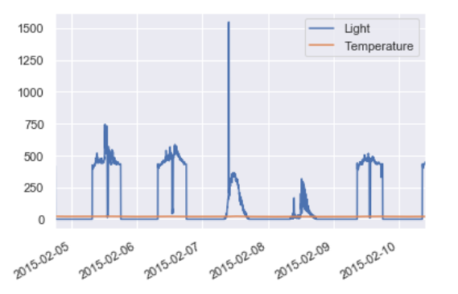
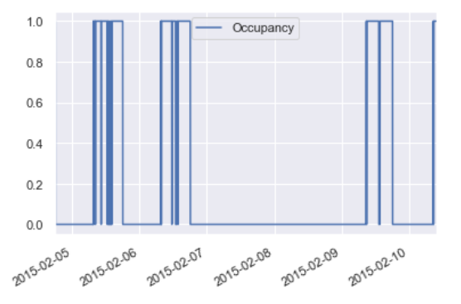

Slide 14
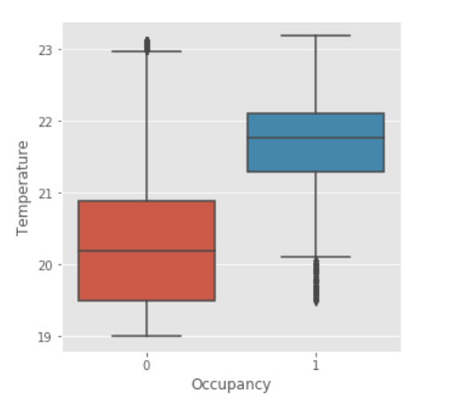
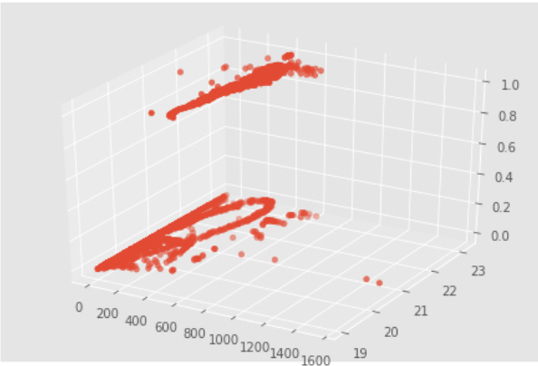

Slide 15
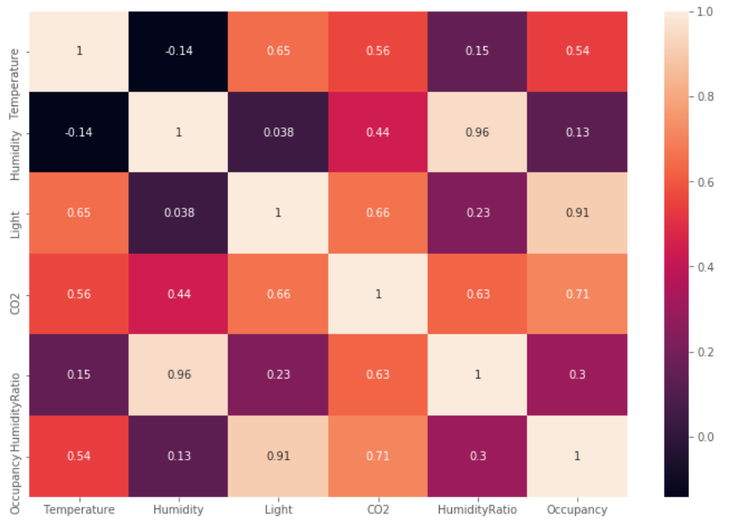
Correlation of Dataset

Slide 16
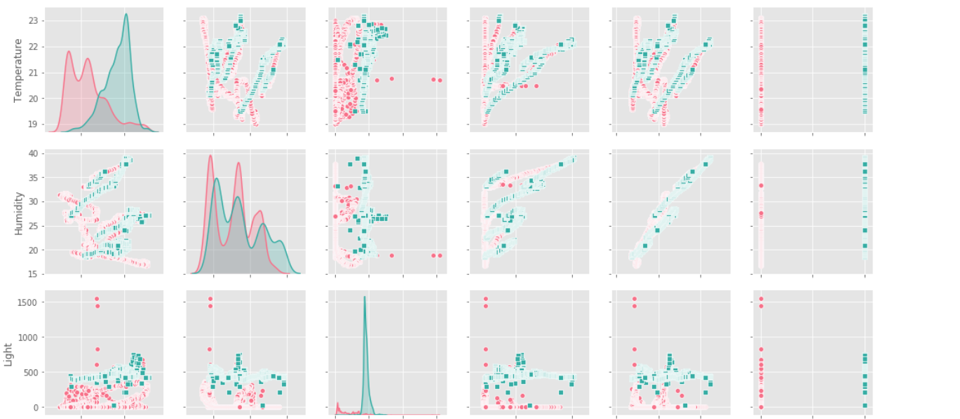
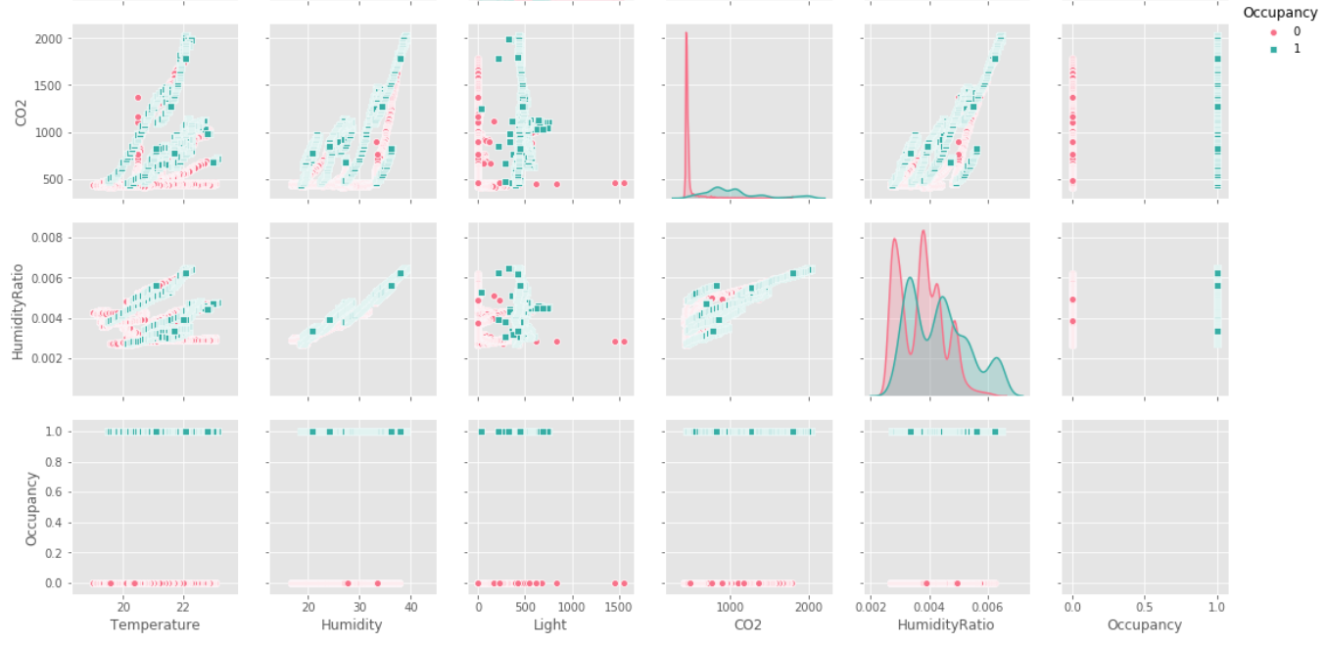

Slide 17
Regression Analysis

Slide 18
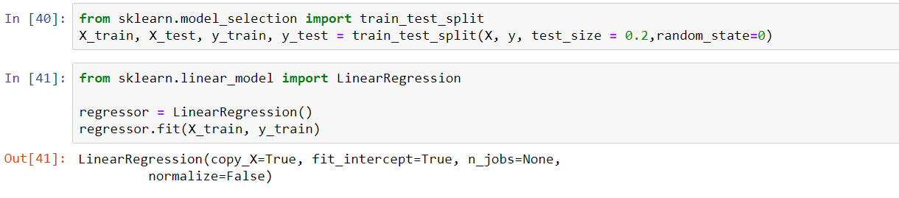
Linear Regression
Linear regression attempts to model the relationship between two variables by fitting a linear equation to observed data. One variable is considered to be an explanatory variable, and the other is considered to be a dependent variable.

Slide 19
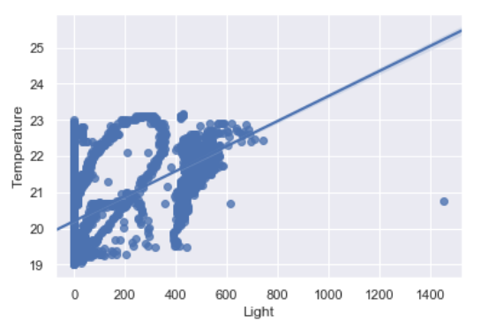
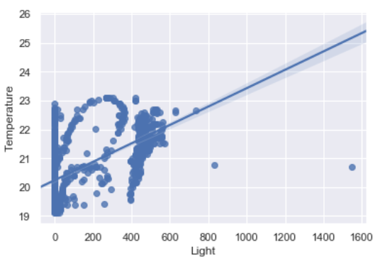
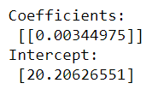
Visualization of Linear Regression
Training Set
Testing Set

Slide 20
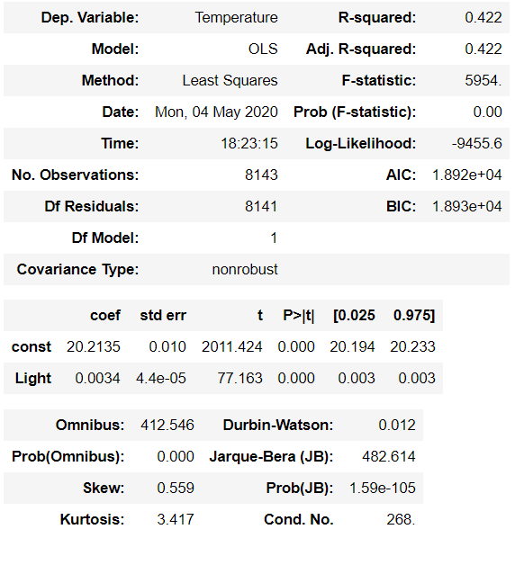
Summary

Slide 21
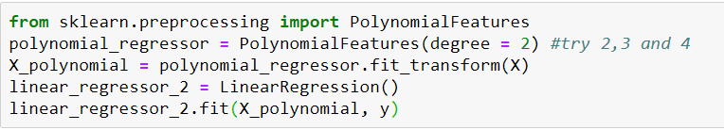
Polynomial Regression
Polynomial regression is a form of regression analysis in which the relationship between the independent variable x and the dependent variable y is modelled as an nth degree polynomial in x.

Slide 22
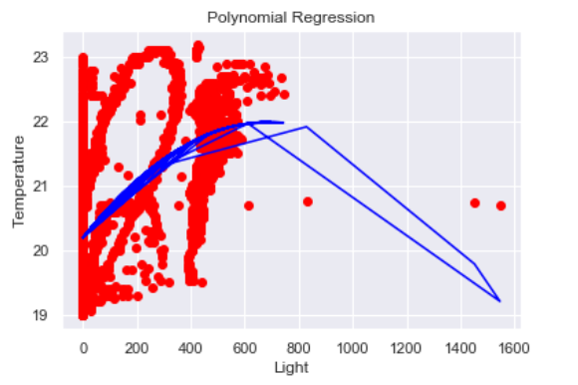

Visualization of Polynomial Regression
Result

Slide 23
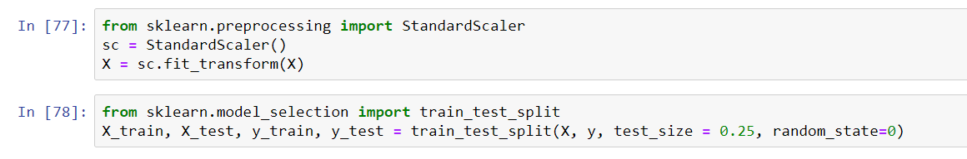
Logistic Regression
Logistic regression is a statistical method for analyzing a dataset in which there are one or more independent variables that determine an outcome. The outcome is measured with a dichotomous variable (in which there are only two possible outcomes).
The goal of logistic regression is to find the best fitting model.

Slide 24
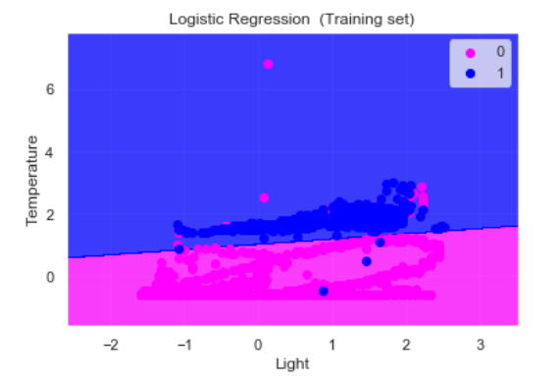
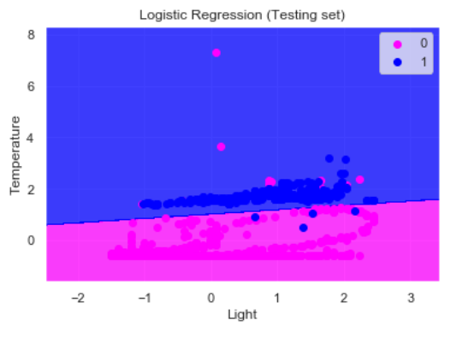
Visualization of Logistic Regression

Slide 25
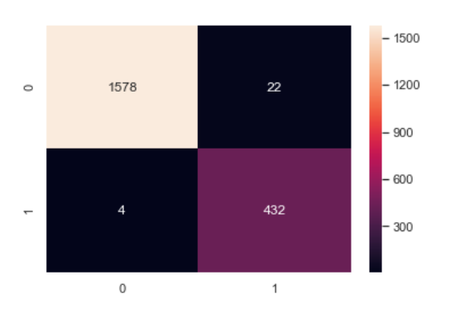
Confusion Matrix

Slide 26
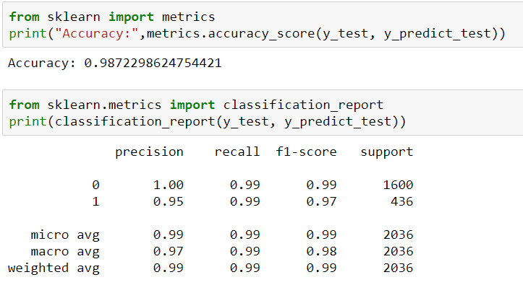
Classification Report

Slide 27
Classification Model

Slide 28
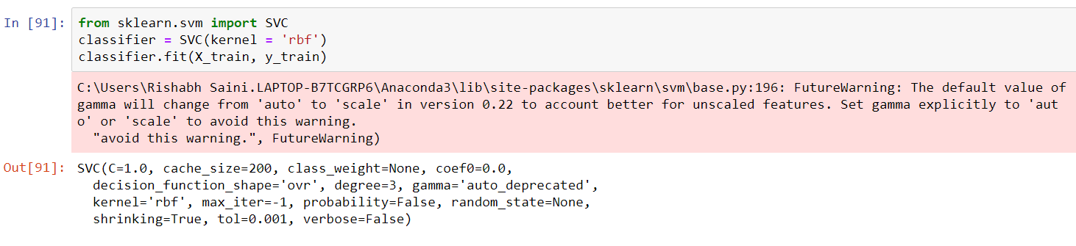
Support Vector Machine(SVM)
A support vector machine (SVM) is machine learning algorithm that analyzes data for classification and regression analysis. SVM is a supervised learning method that looks at data and sorts it into one of two categories. An SVM outputs a map of the sorted data with the margins between the two as far apart as possible. SVMs are used in text categorization, image classification, handwriting recognition and in the sciences.

Slide 29
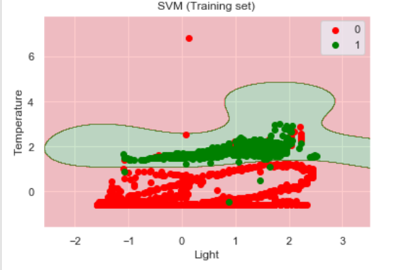
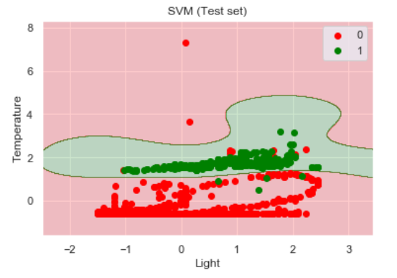
Visualizing SVM

Slide 30
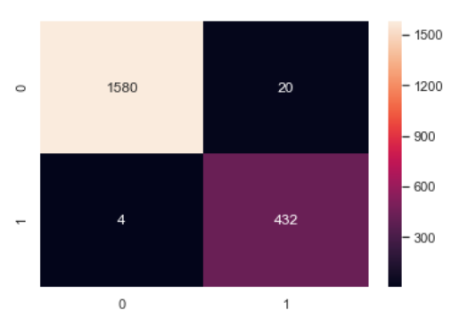
Confusion Matrix

Slide 31
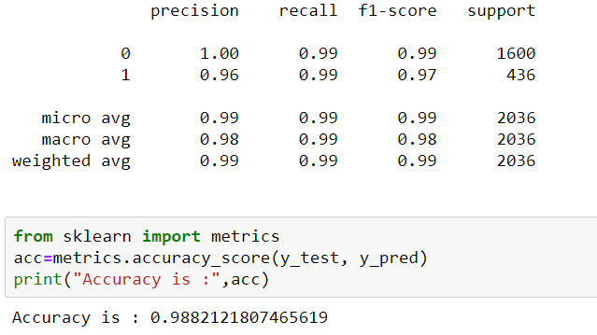
Classification Report

Slide 32
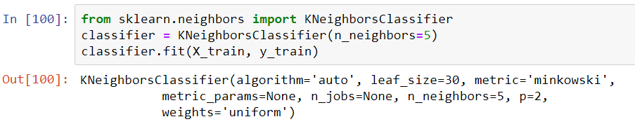
KNN
A K-nearest-neighbor algorithm, often abbreviated k-nn, is an approach to data classification that estimates how likely a data point is to be a member of one group or the other depending on what group the data points nearest to it are in.

Slide 33
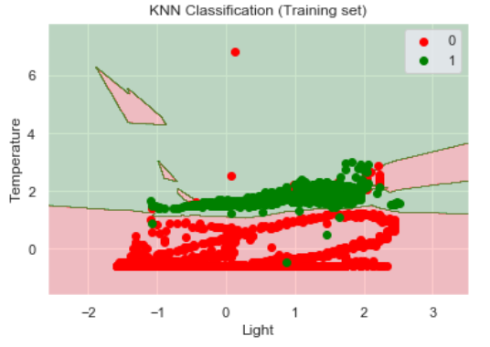
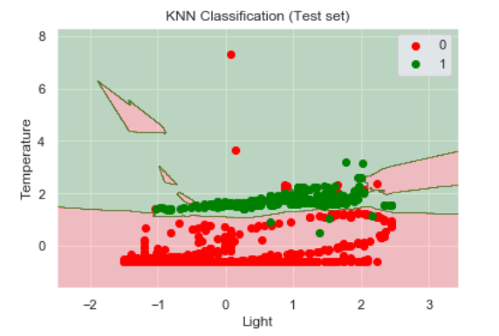
Visualizing KNN

Slide 34

Confusion Matrix

Slide 35
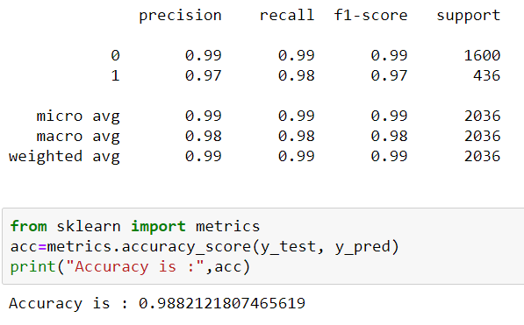
Classification Report

Slide 36
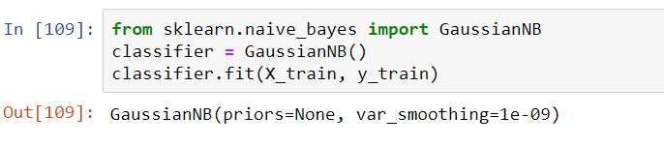
Naive Bayes
The Naive Bayesian classifier is based on Bayes’ theorem with the independence assumptions between predictors. A Naive Bayesian model is easy to build, with no complicated iterative parameter estimation which makes it particularly useful for very large datasets. Despite its simplicity, the Naive Bayesian classifier often does surprisingly well and is widely used because it often outperforms more sophisticated classification methods.

Slide 37
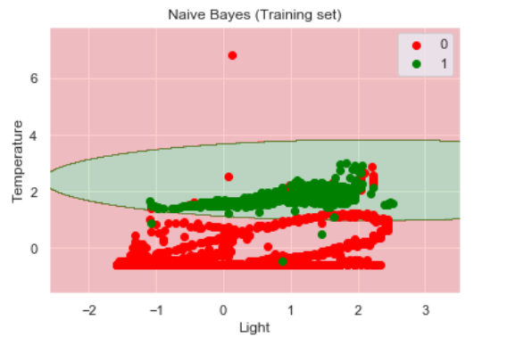
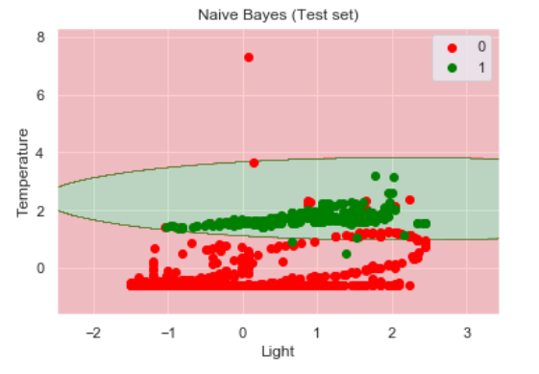
Visualizing Naive Bayes

Slide 38
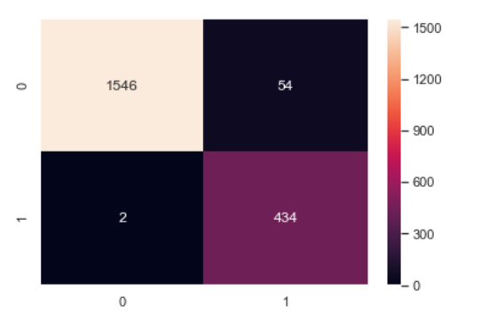
Confusion Matrix

Slide 39
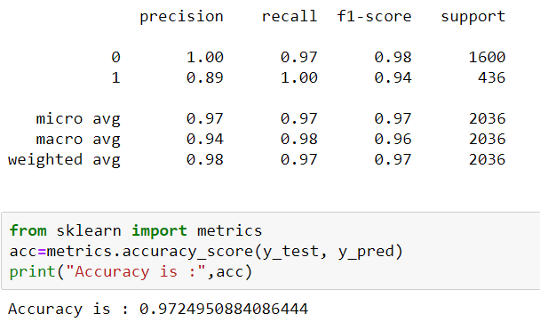
Classification Report

Slide 40
We can see that only the “Light” variable is required in order to achieve 99% accuracy on this dataset.
It is very likely that the lab rooms in which the environmental variables were recorded had a light sensor that turned internal lights on when the room was occupied.
Alternately, perhaps the light is recorded during the daylight hours (e.g. sunshine through windows), and the rooms are occupied on each day, or perhaps each week day.

